Slide 1
Entity-Based Document Classification on the CORD - 19 Corpus
Gollam Rabby and Tomas Kliegr
Department of Information and Knowledge Engineering, VSE University, Prague, Czech Republic

Slide 2
Project
1. Transforming CORD-19 to a flat csv file (e.g. with resources corresponding to columns) to which standard rule learning tools/algorithm can be applied. 2. The task is to predict the (academic) success of a paper (as measured by citations).
3. Since we use an "explainable" machine learning tool/algorithm, we could find which combination of concepts (e.g. chemical substances) is predictive of paper success.
Sample discovered rules

Slide 3
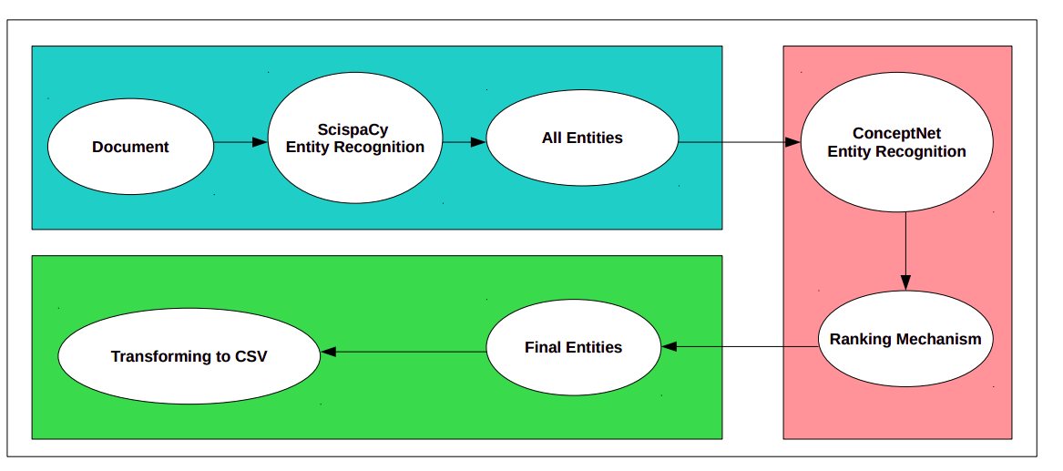
Project - Pre-processing data

Slide 4
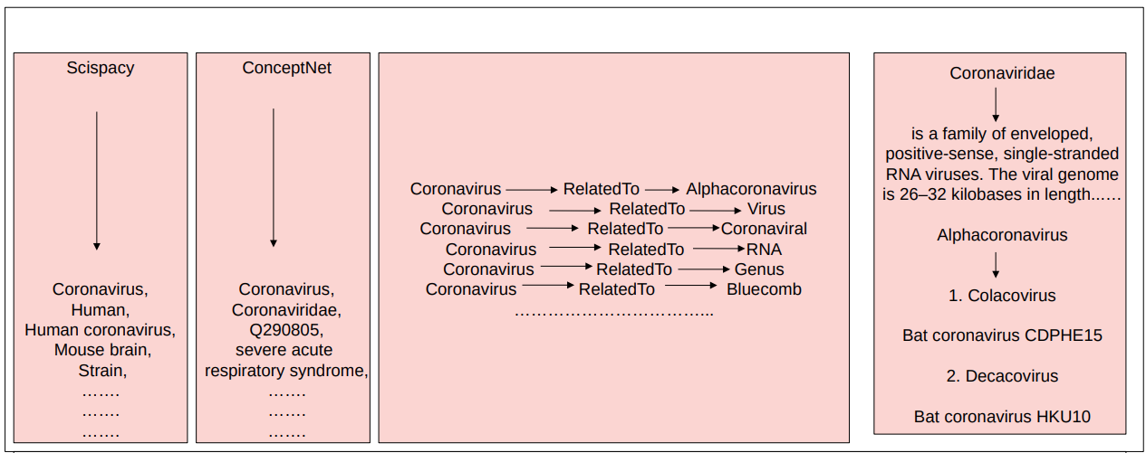

Slide 5
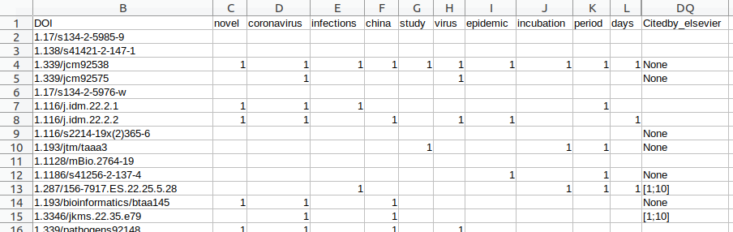
Mining from Tabular: Result of preprocessing

Slide 6
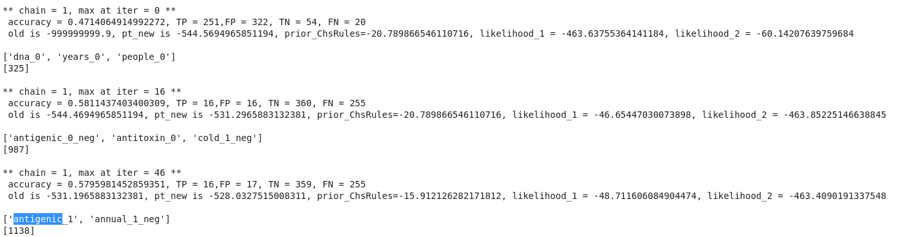
Mining Tabular: Association rule mining with Bayesian Rule Set mining

Slide 7
Summary
1. Ways to generate higher quality entities, assign weights to entities, remove uninteresting entities. Currently, we have experimented with Scispacy, ConceptNet, Scispacy with ConceptNet and TF-IDF model.
2. We use a number of citations (OpenCitations Ontology) as a proxy of the significance of results reported in the paper. Do you have a better suggestion?
3. Use SBRL, CORELS and Random Forest for finding the combination of concepts from research papers.

Slide 8
Future Work
1.Building a knowledge graph (KG)
2. Prediction of missing triples in KG
3. Classification in KGs
4. Clustering of similar rules

